Slide 1
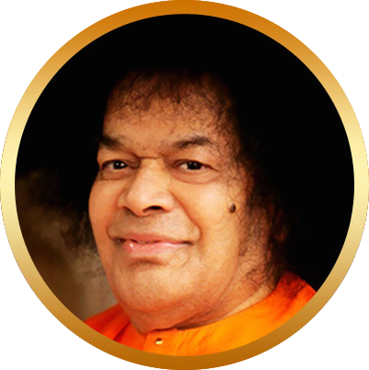


Bhajan
Meaning
Scale
NextBhajan
NextScale
Living His Message
Practical Spirituality

